Slide 1
中文1 9月12日 星期二

Slide 2
祝你生日快乐!
https://www.youtube.com/watch?v=AerP9lgnvEs

Slide 3
What we learned yesterday我们昨天学的
xiè xie （nǐ)
谢 谢 (你)
Bú kè qi
不 客 气

Slide 4
What we have learnt 我们学过的
A. nǐ hǎo
你 好 ( hello)-----
wǒ jiǎo
我 叫…（ I am called +your name)
nǐ jiào shénme míngzii (What is your name?)
你 叫 什么 名字
wǒ jiǎo
我 叫…（ I am called +your name)
zài jiàn
再 见 （bye)
Nǐ hǎo ma ?
你 好 吗？(How are you?)
Wǒ hěn hǎo
我 很 好. ( I am very well.)

Slide 5
中国地理zhong1guo2 di4li3 China Geography

Slide 8
Today, Chinese has an official language status in five countries/regions or territories. In China and Taiwan it is the sole official language as Mandarin, while inSingapore (as Mandarin) it is one of the four official languages.
Co-Official language (As Cantonese in Hong Kong alongside English, and in Macau alongside Portuguese)

Slide 9
Tiananmen Square 天安门广场

Slide 10
Forbidden City 故宫

Slide 11
Great Wall 长城

Slide 12
China US
Captial Beijing ,
Area 3,705,407
Population 1,302,275,514
Location
Time zone : 5
Beijing Time ( one standard time)
Washintong. DC
3,717,813
294,275,788
6
(not summer time)
Eastern Time -13
Center Time -14
Mountain Time-15
Pacific time zone -16
Alaska Hawaii time-17, 18

Slide 13
Population

Slide 14
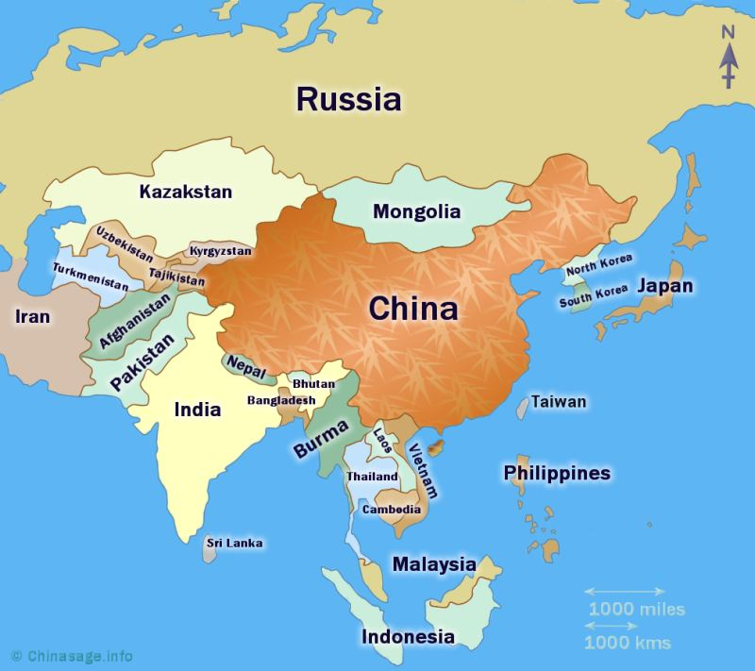
China nabours

Slide 15
Pinyin : Initials and Finals Chinese for Kids | Song to Learn Pinyin in 4 minutes! https://www.youtube.com/watch?v=ocgsflnEgqY https://www.youtube.com/watch?v=XTMQuoHOVDI Learn Chinese - bō pō mō(Chinese pinyin song)

Slide 16
https://www.youtube.com/watch?v=cbZR_m8SjjM

Slide 17
Nonboring countries

